Slide 1


Slide 2

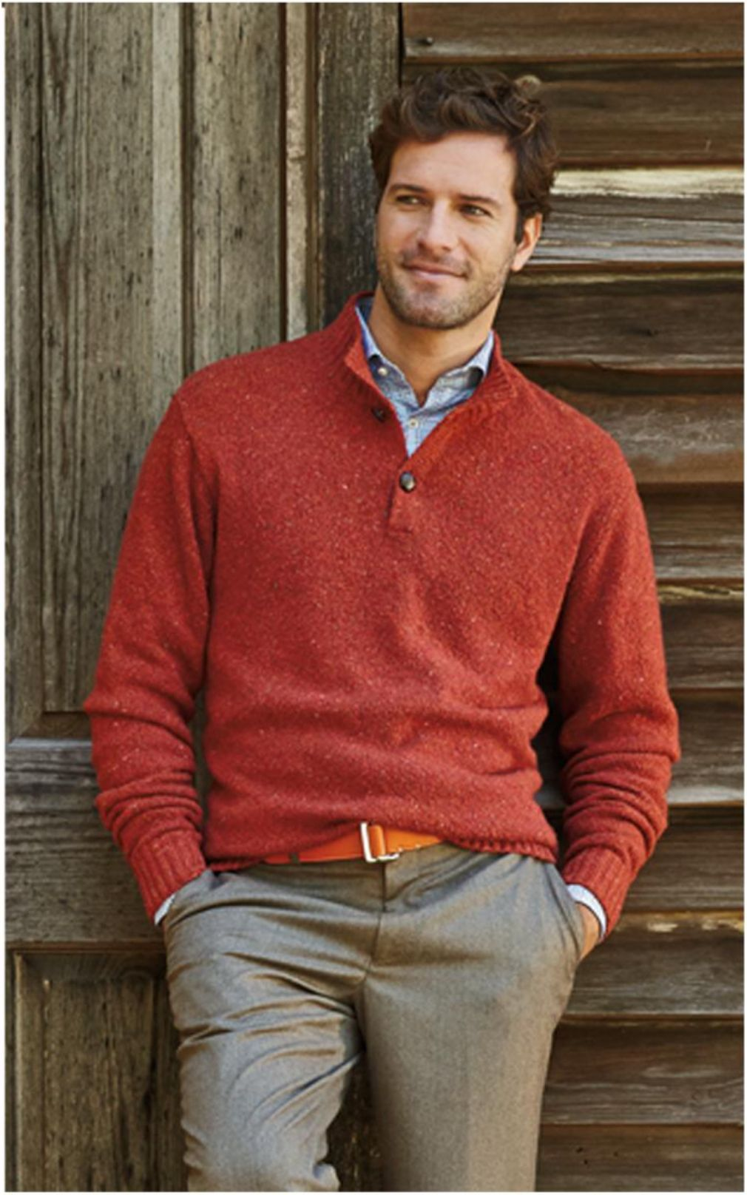
Company Profile
Table Of Contests
Company Overview
Company At A Glance
Products
Clients
Design & Development
Quality Control & Assurance
Recognition

Slide 3
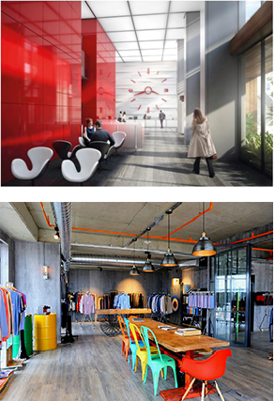
Company Overview
COTTEX is a top quality supplier catering to premium menswear brands around the world servicing its clients over 15 years. We are trying to get close to all our clients with our showroom in Istanbul.
COTTEX has field office in China & Vietnam, with advanced experience and acknowledged success in sourcing and production of garment, fabrics and trims. With own offices and team located in Shanghai & Ho Chi Min cities to follow, manage and inspect all the production processes for its clients to cater orders on-time assuring the perfect quality.
COTTEX follows up the global trends and developments and always remains globally up-to-date about the dynamics of the fashion market. Each client’s needs and expectations are serviced with customized development processes, whether they are retailer or wholesaler brands.
COTTEX provides creative solutions to variety of customer demands with its extensive experience regarding research and development with the principle of highest standard production.
COTTEX enables its clients to overcome challenges in production overseas by offering reliable service, best workmanship, flexibility about quantities and highly competitive price policy.

Slide 4
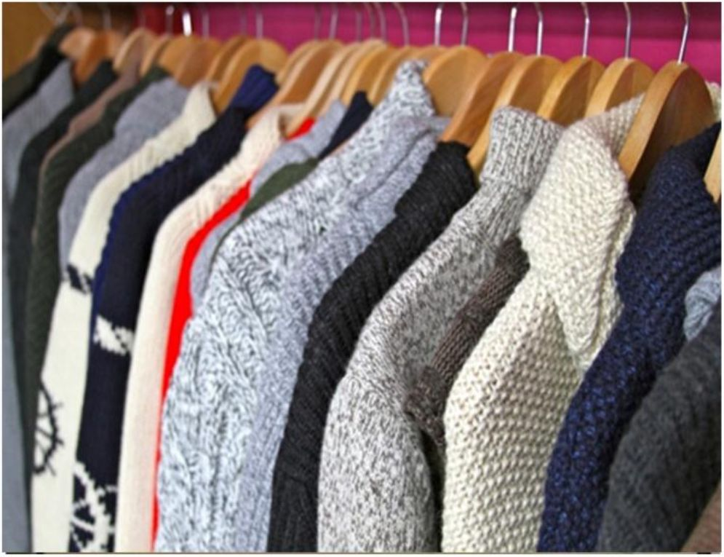
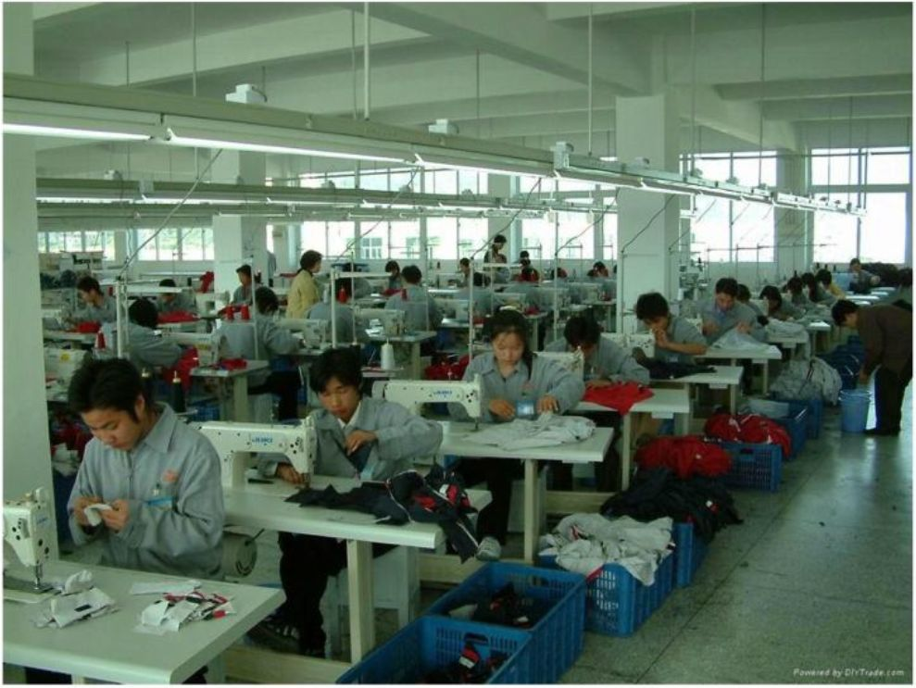
Company at a Glance
Company Name : COTTEX LLP
Type of Business : Manufacturer and Exporter
Contact Person : Asim YAGCI /+90 212 210 50 28
Marketing Office : Merkez Mah. Akar Cad. No: 3 Kat: 19 ITOWER Plaza, Bomonti 34381 Sisli- ISTANBUL
Email: asim@cottexllp.com
Web: www.cottexllp.com
Production per year for Tricots (Sweaters) 100,000 pcs.
Production per year for Woven Shirts 250,000 pcs
Production per year for Polo-TShirts 150,000 pcs
Production per year for Bottoms 100,000 pcs
Production per year for Outwear
Total Turnover per year 25,000,000 USD

Slide 5
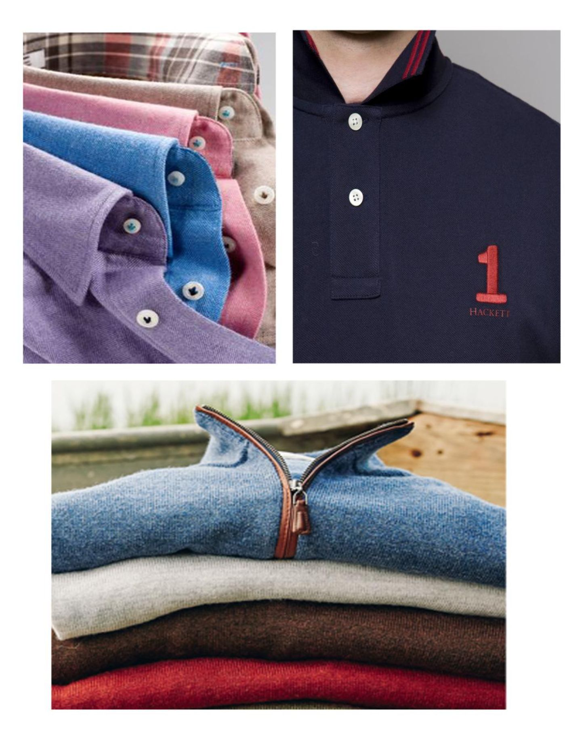
Products
Over the years, COTTEX has manufactured a wide variety of products, such as: woven shirts, knitwear , polo shirts, chino,swim shorts and outerwear.
Shirts: COTTEX is cooperating with the integrated factories in China & Vietnam which have also their own fabric productions. COTTEX uses only high quality fabrics to achieve chic and comfortable shirts. We have 2 fabric collections every year so that our clients can arrange their collections from our wide design pallets.
Knitwear: Available gauges are: from 3 gauge to 16 gauge. Cottex generally uses %100 merino wool, merino/cash, merino/cot, %100 cotton, %100 mercerized cotton, cotton/cashmere, cashmere/silk, merino/silk, 100% silk, silk/lino and 100% lino blends. Since we are using mostly stock yarn services, our quantities are very flexible like 100 pc/ col/ style.
Polo Shirts: Very fine blended yarns are used such as pima cotton, cot/silk, %100 linen, lino/cot, cot/bamboo, cot/cash,performance poly & nylon etc.
Chino: We are developing new fabric qualities every season to provide fashionable and completely respectable styles to our clients.. Garment dyed or yarn dyed we produce classic 5-pocket, Chino, golf pants and short styles by using very special blends like cot/stretch, Cotton / Linen, Cotton /Linen Stretch,nylon/stretch, Cotton/Wool ,cot/nylon/stretch etc.
Outerwear: We produce, high-class outerwear styles perfectly, satisfying any functional and design demands. Quilted, padded, bomber and ultra- light down jacket and vest styles are our main products.

Slide 6










Clients
HACKETT ENGLAND
PETER MILLAR USA
VINEYARD VINES USA
VINCE USA
FAHERTY USA
KJUS USA
JOHN VARVATOS USA
JOHNIE -O USA
GREYSON USA
ROBERT BARAKETT CANADA
TODD SNYDER USA
SCOTT BARBER USA
RYE51 USA

Slide 7
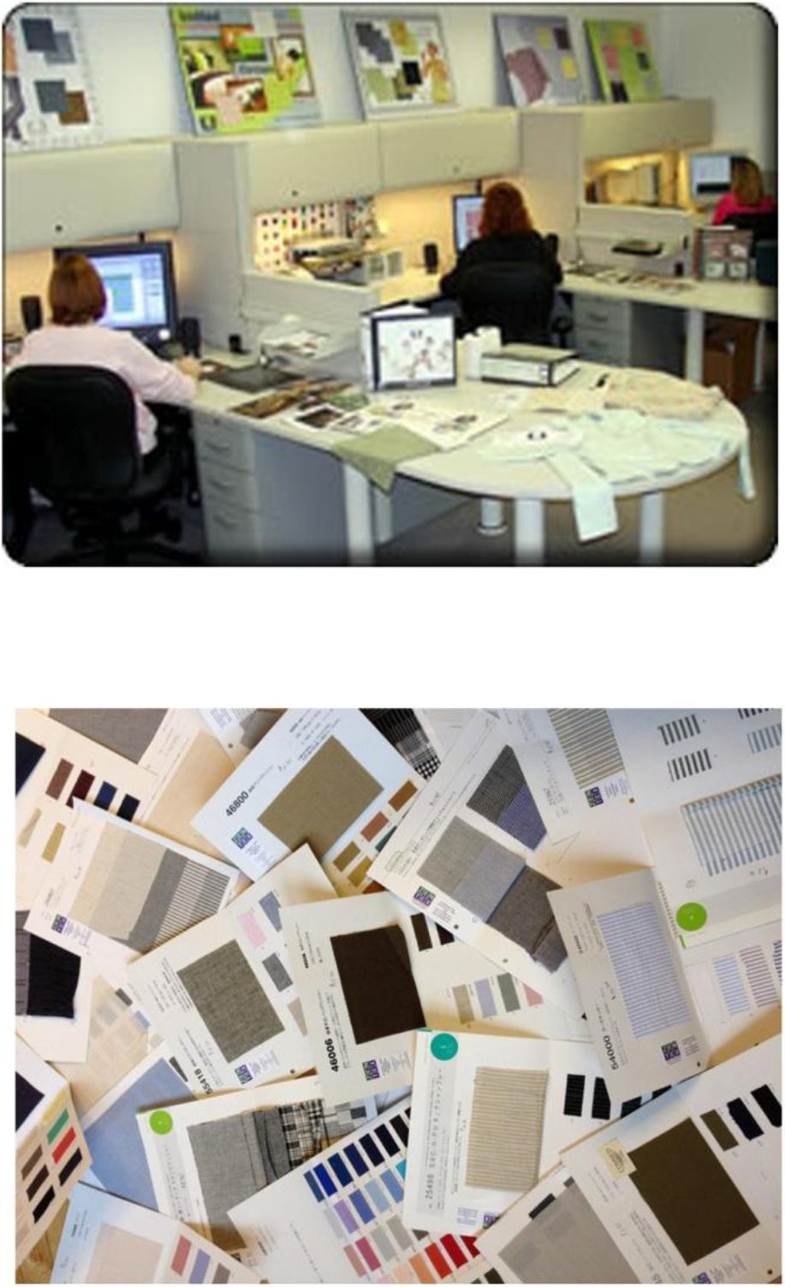
Design & Development
COTTEX can comprehend the swinging-pendulum of the fashion world and can therefore adapt to the taste of trendy consumers.
COTTEX has restructured its Sample-Division into a Design & Development Unit. This fully-fledged section, headed by a Fashion Designer, prepares the seasonal collections according to the latest market-trends.
COTTEX’s insightful Research and Development Team is always on the lookout for new types of fabrics and products aiming to achieve better results in client-management.

Slide 8
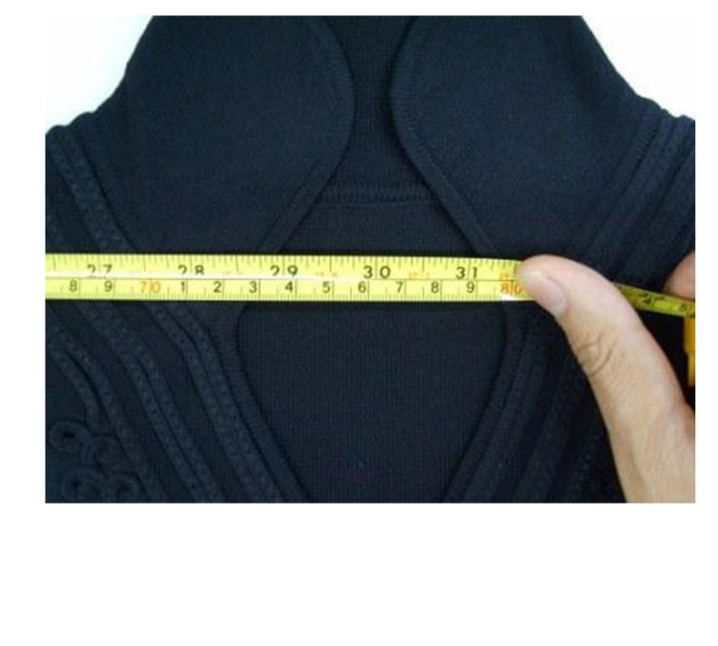
Quality Control &
Assurance
Throughout its decade-long operation, COTTEX has perfected its Quality Control System.
COTTEX has a QA team provides no room for error and can readily assure superior product-quality to its clients.
At COTTEX, the client satisfaction is the company-satisfaction.

Slide 9

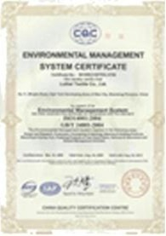
Recognitions
Certificate No: C808683OE-01.2009 Range: TEXTILE
Reference: CONTROL UNION CERTIFICATIONS
Name: ISO14001:2004
Certificate No: 00109E21657R3L/3700
Date: Aug 24, 2009
Valid until: Aug 23, 2012
Range: TEXTILE
Reference: CHINA QUALITY CERTIFICATION CENTER
Name: ISO9001:2008
Certificate No: 00109Q210642R2L/3700
Range: TEXTILE
Reference: CHINA QUALITY CERTIFICATION CENTER
Name: Oeko-Tex Standard 100
Certificate No: SWAA 027848
Range: TEXTILE
Reference: Insitute of the international Association for research

